Slide 1
OS ARCHITECTS Present: Musify
Search
Home
Library
A Music Streaming Web Application

Slide 2
Table of contents
01
02
03
04
Problem Statement
Musify Features
3:15min
3:15min
Aim & Objective
Development & Roadmap
3:15min
3:15min

Slide 3
Problem Statement
We face a lot of problems with our Online Music Streaming platforms nowadays such as:
Audio Quality
Lack of Personalization
Expensive Subscription
No offline playback option
With MUSIFY we strive to provide a easy to use application which solves all these problems and provides quality music.

Slide 4
Our Aim & Objective
Provide a Seamless Music Streaming Experience
Provide Free Services
Wide Music Selection
Offer Personalization
Encourage Music Discovery
Cross-Platform Accessibility

Slide 5
Musify Features
Search
Musify provides a quality platform for streaming music.
Some of its Features are :
Free of Cost
User Registration and Profiles
Music Library
Playlist Creation
Offline Listening
Easy Download
Home
Library

Slide 6
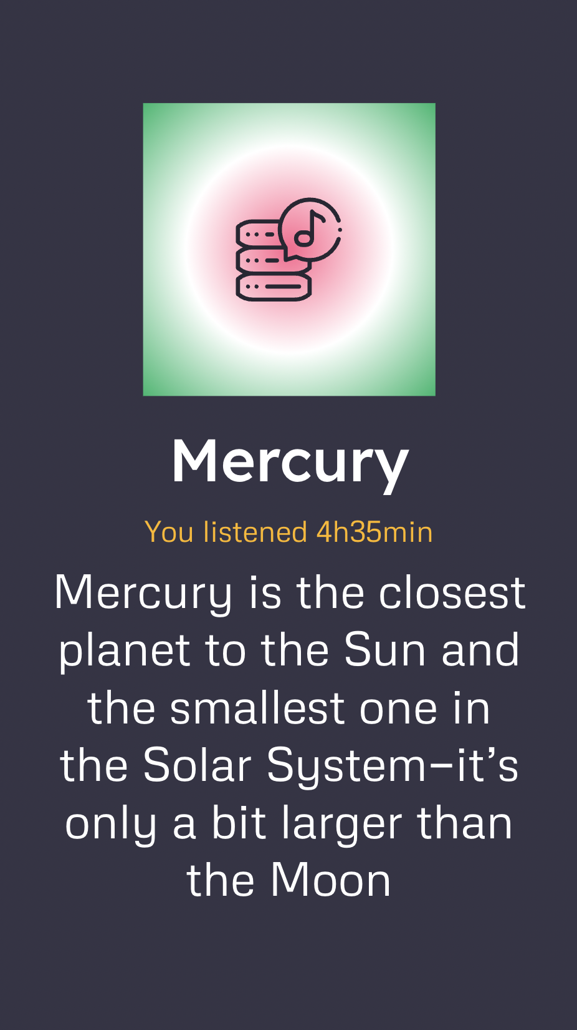
Technologies Used
MUSIFY
HTML/CSS: For structuring and styling the web application.
JavaScript: For interactive and dynamic features on the front end.
FireBase: To be used as a Database for saving the user credentials.
Platform used – VS Code

Slide 7
Thanks!
Our Music Playlists
Search
Home
Library
Team: OS Archietects
Mithil Mudaliyar RA2211003011476
Kalpesh Bonde RA2211003011502
Gitansh Pise RA2211003011504

